Slide 1
UAVSAR LITE
Steven daniels
Sprint 3

Slide 2
Sprint OBECTIVE
The goal of this sprint was to:
Build a quadcopter simulation

Slide 3
Setting up SITL on Windows
All steps:
https://ardupilot.org/dev/docs/sitl-native-on-windows.html#sitl-native-on-windows
Install Cygwin as described here
https://ardupilot.org/dev/docs/building-setup-windows-cygwin.html#building-setup-windows-cygwin
Download MavProxy for Windows
https://ardupilot.org/mavproxy/docs/getting_started/download_and_installation.html#mavproxy-downloadinstallwindows
Installation script that installs everything needed:
https://github.com/ArduPilot/ardupilot/blob/master/Tools/environment_install/install-prereqs-windows.ps1

Slide 4
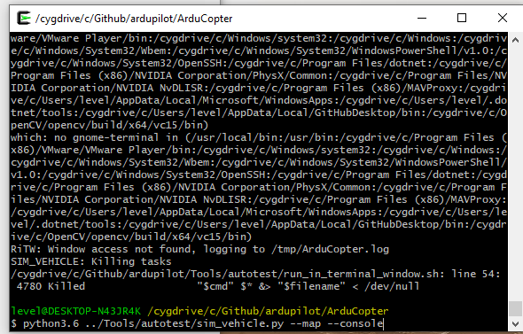
Sitl commands

Slide 5
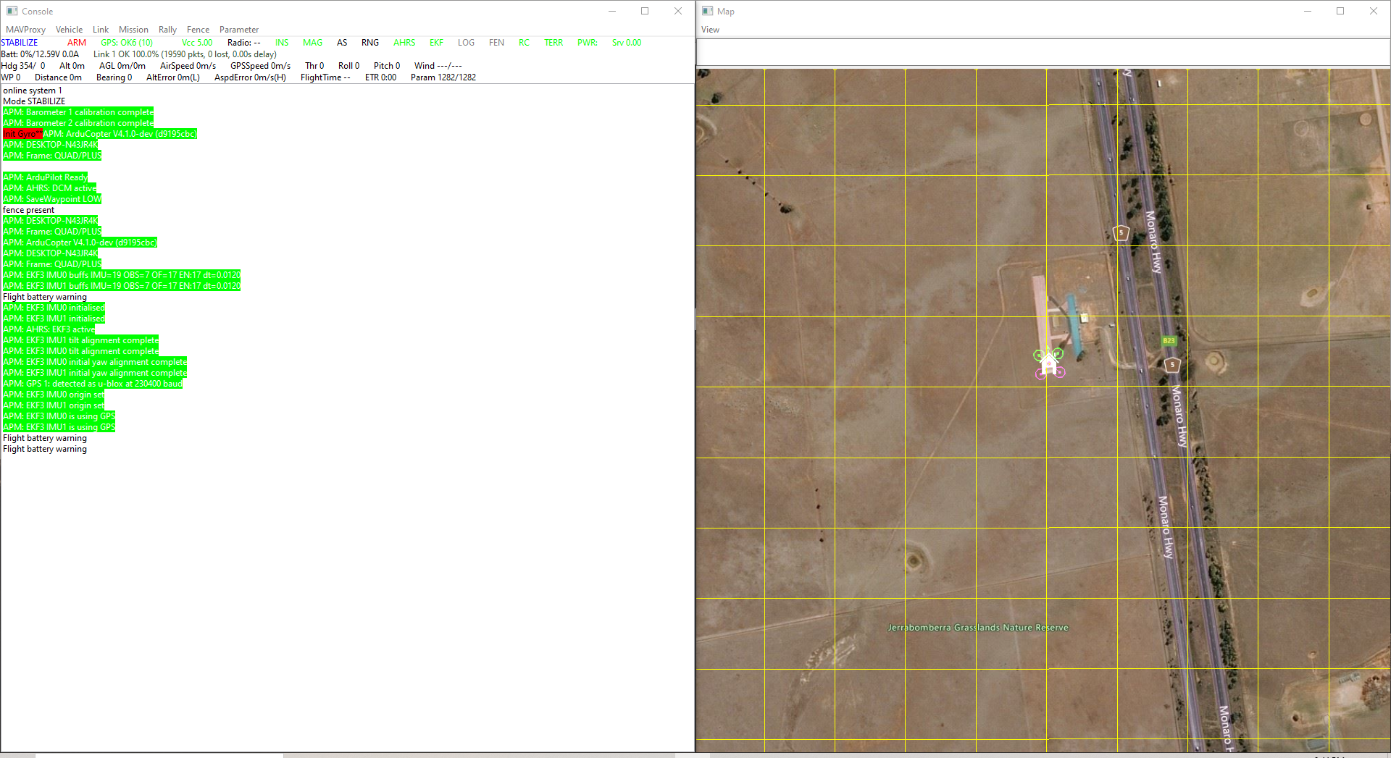
Sitl and mavproxy screen shots

Slide 6
Arducopter flightgear 3d simulator
I choose to use Flightgear because of it’s ease of use to setup and compatibility with Windows and Mavlink.
http://www.flightgear.org/download/

Slide 7
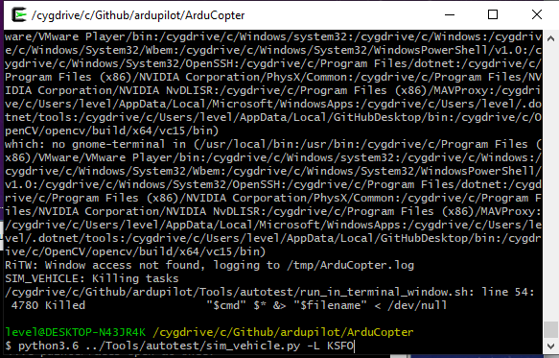
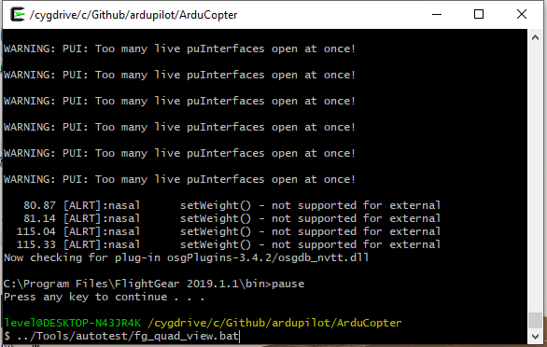
Flightgear commands

Slide 8
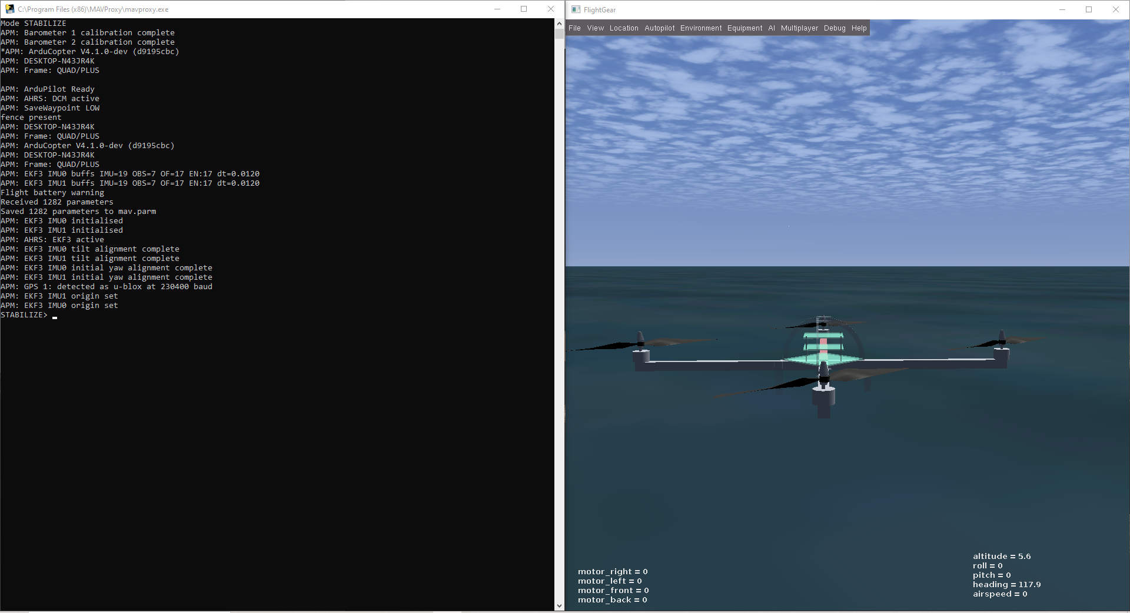
FlightGear 3D View screenshots

Slide 9
Qgroundcontrol
QGroundControl provides full flight control and mission planning for any MAVLink enabled drone. Its primary goal is ease of use for professional users and developers. All the code is open-source source, so you can contribute and evolve it as you want.
QGroundControl is used as the flight controller in the simulation environment. It will also be used as the flight controller for the real drone. Using it now provides a solid test case for the actual drone flight testing.
https://play.google.com/store/apps/details?id=org.mavlink.qgroundcontrol&hl=en_US&gl=US

